Slide 1

Building PDBmapper
GM 11/03/2021
Victoria Ruiz

Slide 2
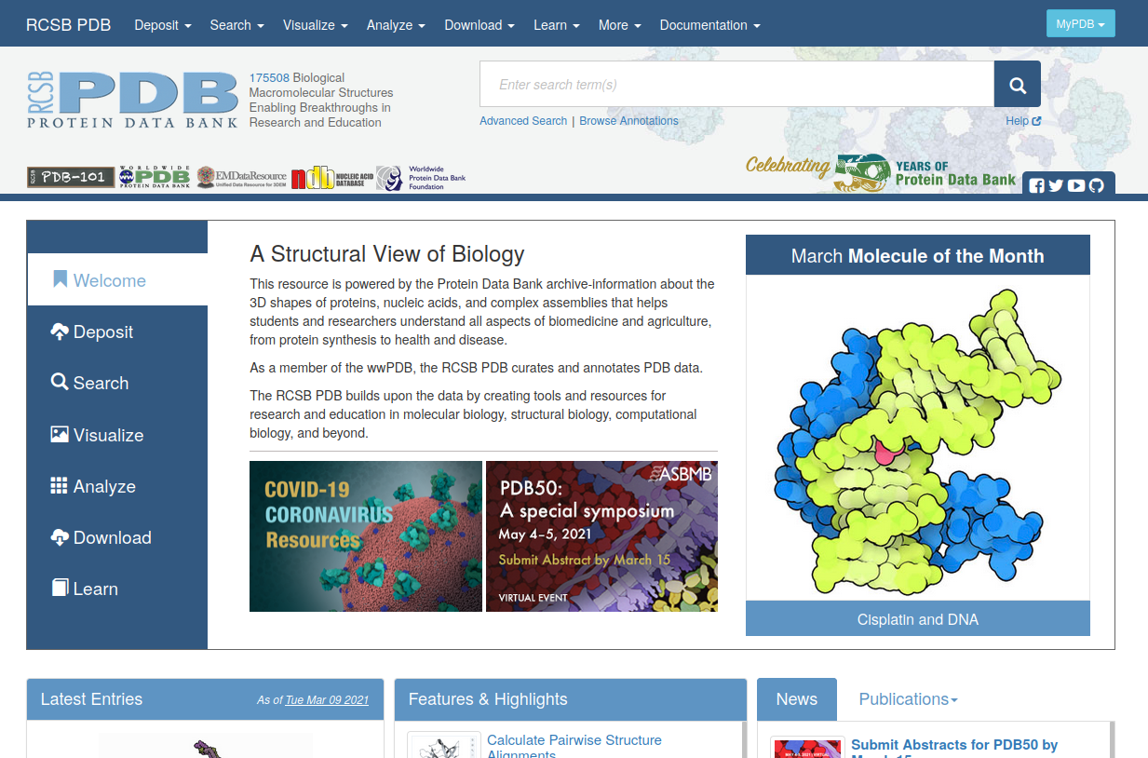

For those who don’t know...

Slide 3
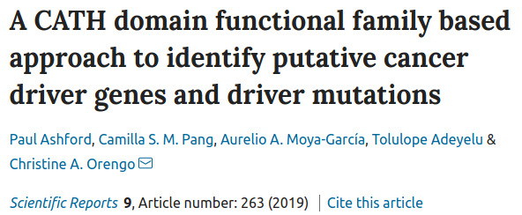
Why PDBmapper?
The analysis of genetic variants on proteins in 3D is biologically more insightful since the protein structure might reveal functional information.
“Variable residues cluster in 3D and 81% lie close to functional sites, interfaces particularly “

Slide 4
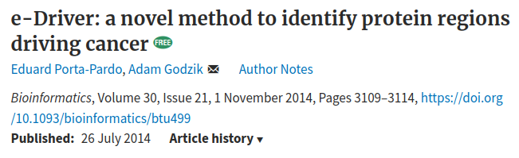
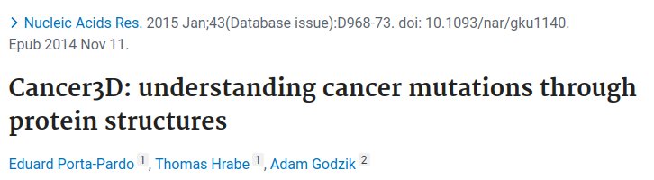
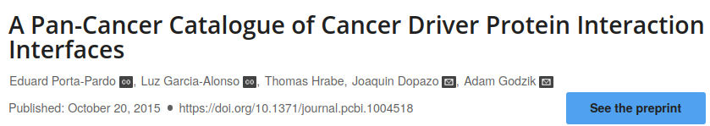
Previous work

Slide 5
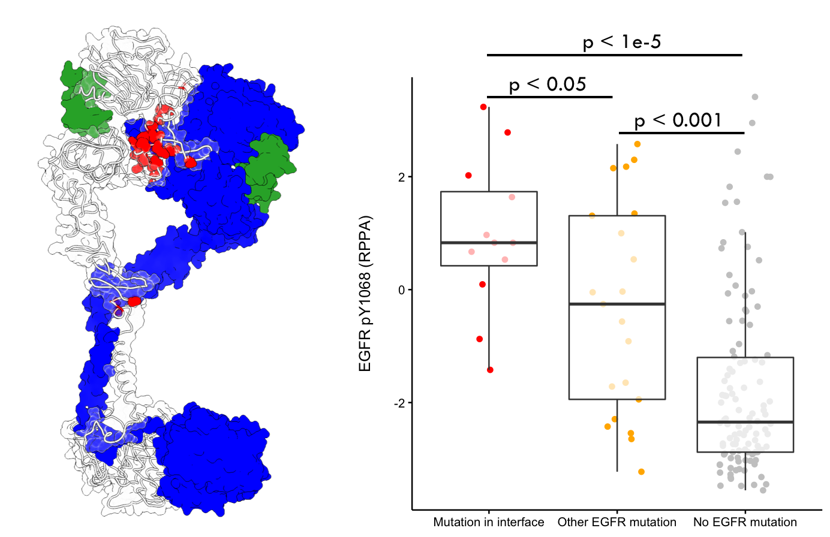
Glioblastoma tumors have different EGFR phosphorylation levels depending on the location of the somatic mutations in the protein structure
Porta-Pardo et. al., Nat. Methods, 2017
Notes:
Cancer disease is characterized by the accumulation of somatic mutations in cells [ref]. These cells may acquire the stem-like cell property of rapidly growing and when they do it in mass, they form tumors. Discerning the nature of tumors can help in designing and selecting proper treatment strategies. For instance, a tumor can be defined as “hot” or “cold” depending on the immune cells composition of its microenvironment. Here we can appreciate this. We can see the great variability of the immune landscape measured in terms of leukocyte fraction, across tumors and different patients of the same tumor that participated in the Cancer Genome Atlas project.

Slide 6
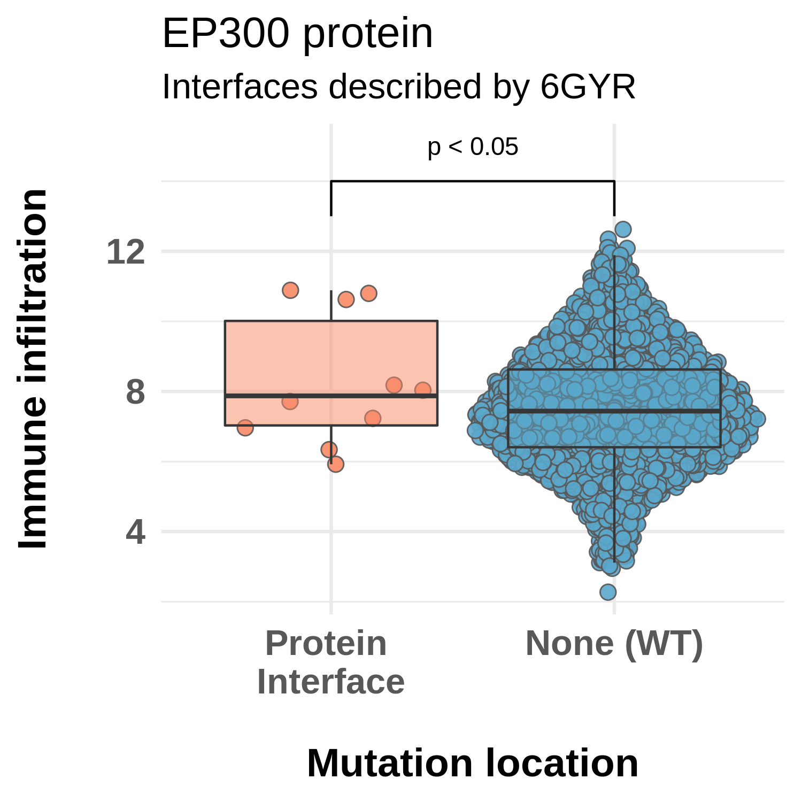
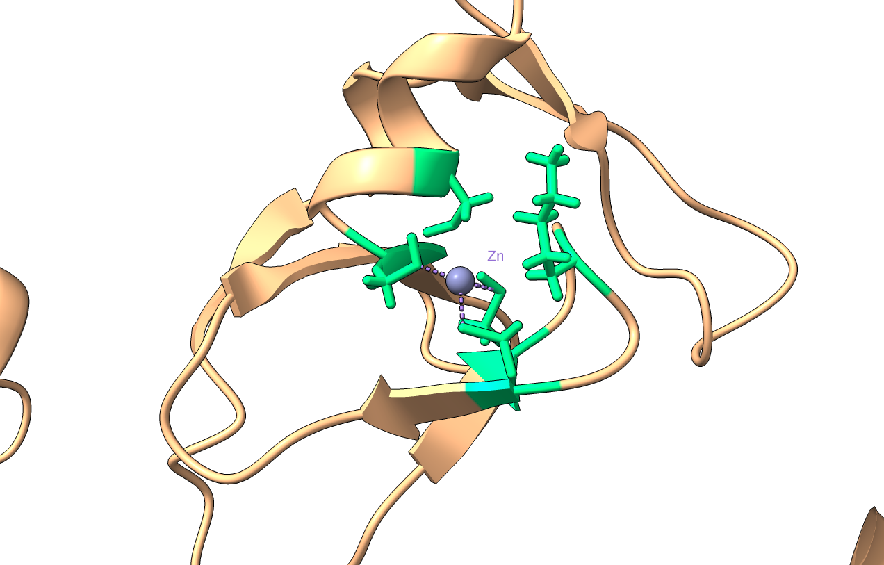
Use case: EP300
A
B
Zn binding site of EP300 (PDB code: 6GYR)
Green: residues of interface with Zn

Slide 7
Use case: EP300
The location of cancer somatic mutations on proteins in 3D allows the discrimination of different degrees of immunological responses in tumors.
Most extreme cases were examined individually

Slide 8
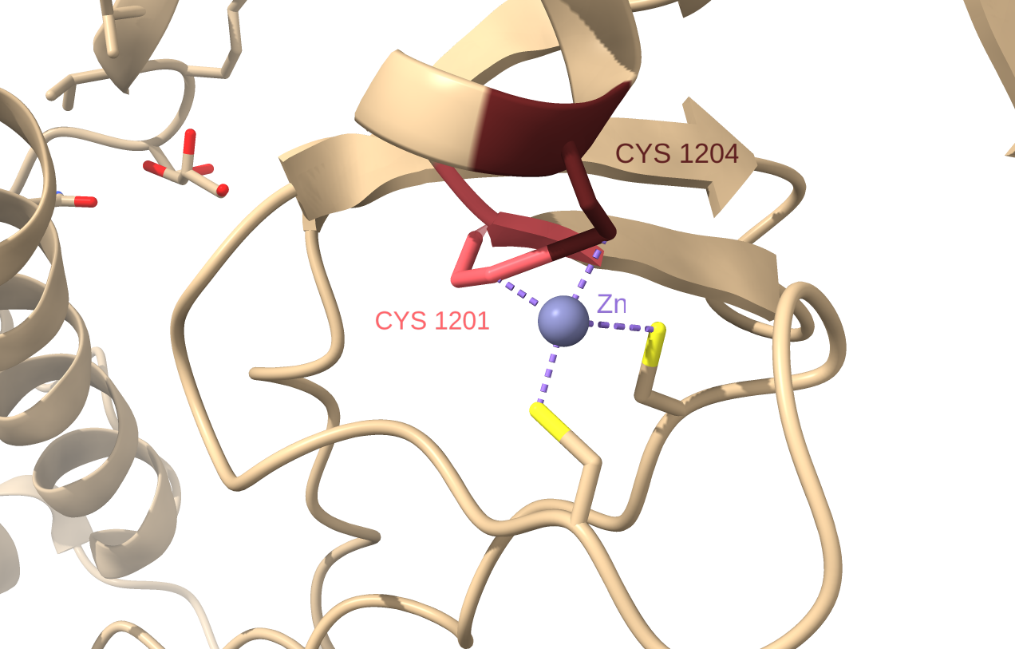
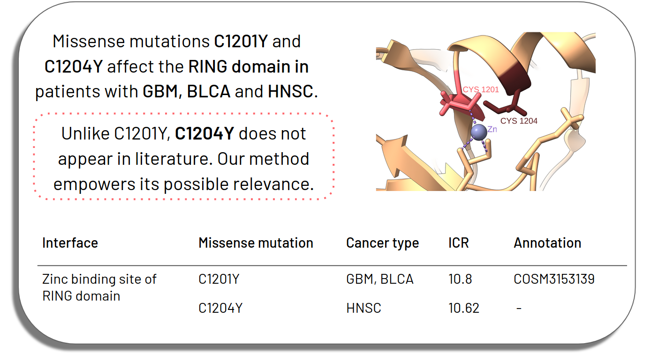
Use case: EP300

Slide 9
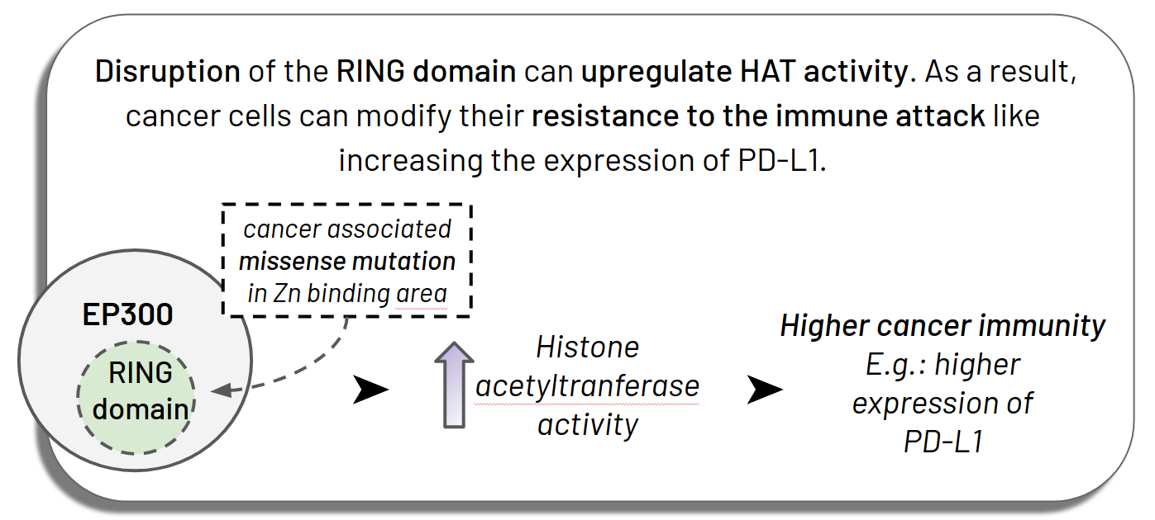
Use case: EP300

Slide 10
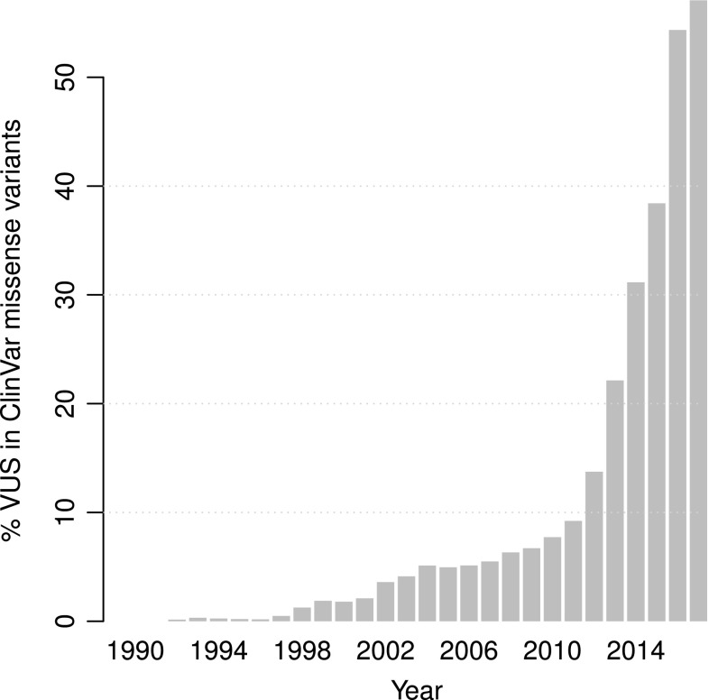
Why PDBmapper?
Growth of DNA sequencing
Sequencing projects are becoming more ambitious.
Variants of Uncertain Significance (VUS) are abundant
Genetic testing
% VUS in ClinVar missense variants over time from 1990 until 2017
Project | Participants
TCGA | ~ 11k
ExAC | ~ 60k
UK Biobank | 500k
100.000 genomes | 100k
All of us | 1M
Whole genome
The whole thing!
Requires more cost for sequencing analysis
Whole exome
22,000 genes
Coding regions only
Untraslated regions
No introns
Only 1% of the genome
But – 85% of disease-causing mutations
Disease-focused panel of genes (tens to hundreds)
Several individual genes
Single genes
From: Weile J, Roth FP. Multiplexed assays of variant effects contribute to a growing genotype-phenotype atlas. Hum Genet. 2018;137(9):665-678.
From: Lindor NM, Thibodeau SN, Burke W. Whole-Genome Sequencing in Healthy People. Mayo Clin Proc. 2017;92(1):159-172.

Slide 11
State of the art:
Sequence-to-structure mapping tools:
SNP2Structure
Mutation3D
HotSpot3D
HotMAPS
GenProBis
3D Hotspots
ZoomVar
Summary of what they do:
Identify cluster mutations in 3D
Summary of what they don’t do:
Identify the area of the protein

Slide 12
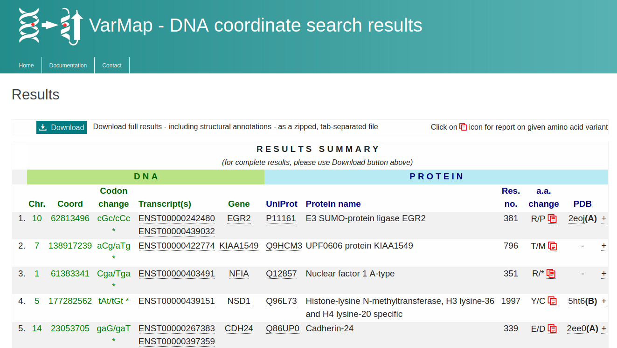

Slide 13
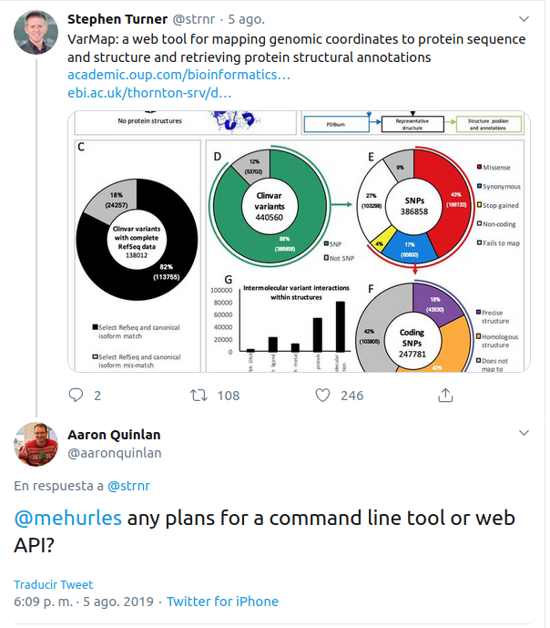
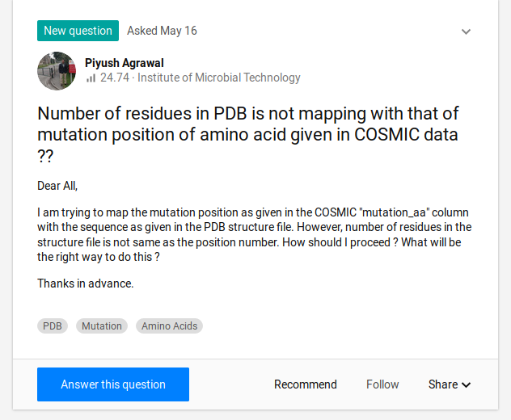
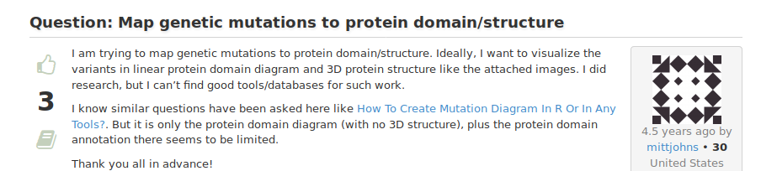

Slide 14
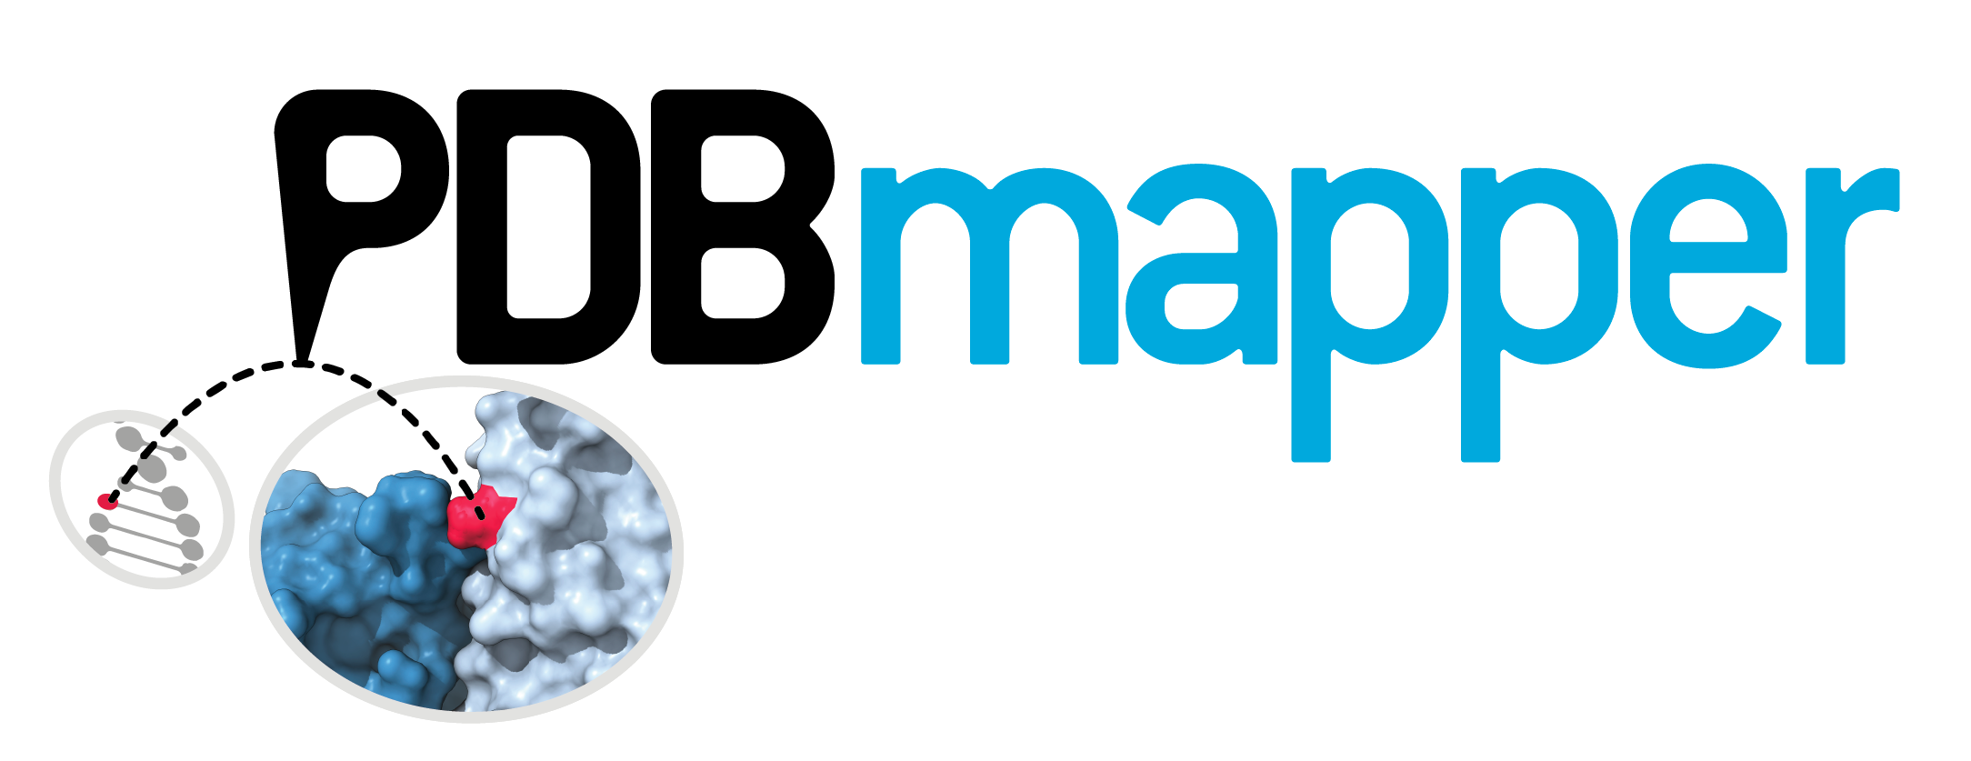
Why PDBmapper?
Flexible tool to systematically integrate genomic and protein structure data.​
Possibility to map new VUS
Optimized code to manage large volume of data in a reasonable amount of time
Map genomic variants to
protein structure data in 3D.

Slide 15
Methods

Slide 16
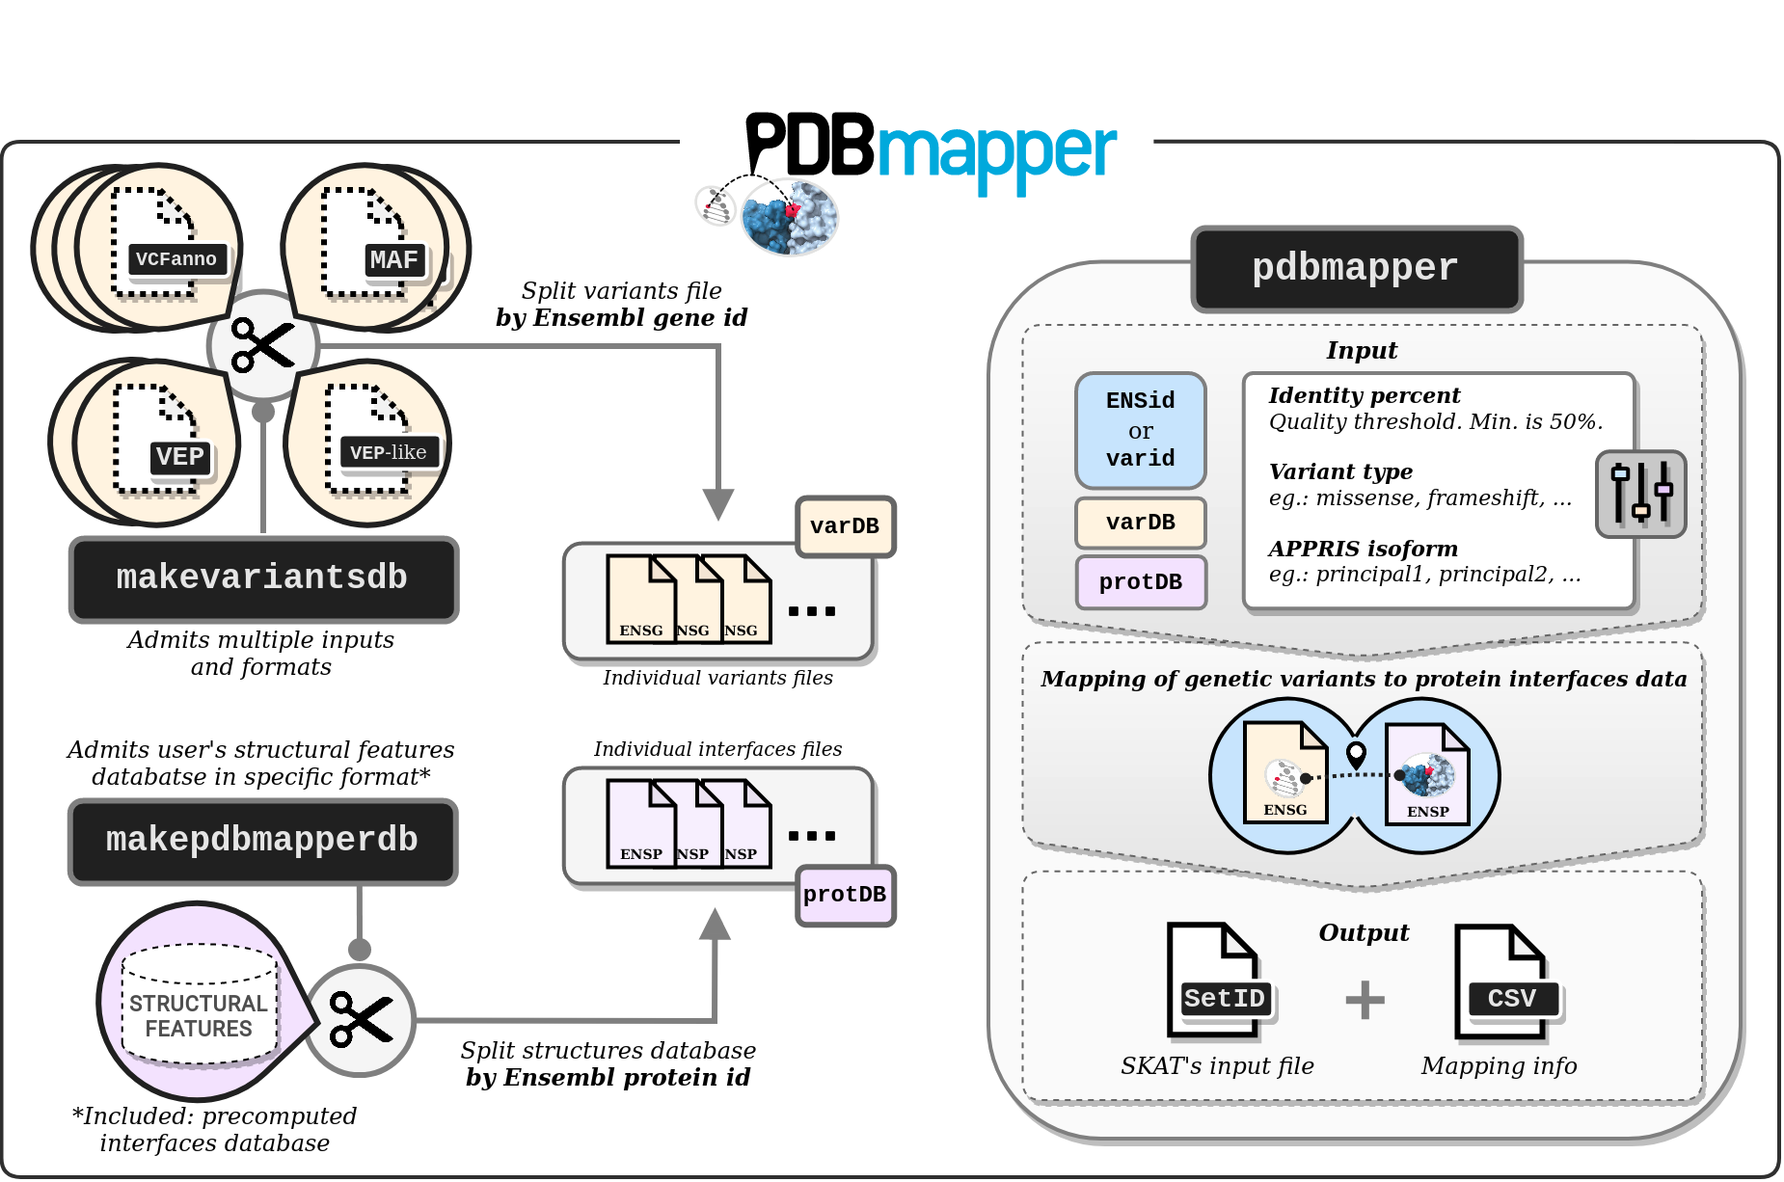
Methods
VARIANTS INPUT
MAPPING
Command line tool
Python
Easy installation
pip install
PROTEIN FEATURES INPUT
Flexible
Containerization

Slide 17
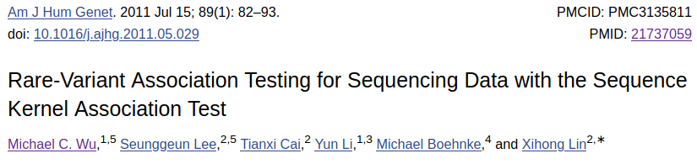

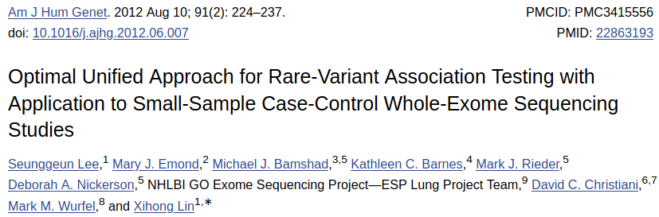
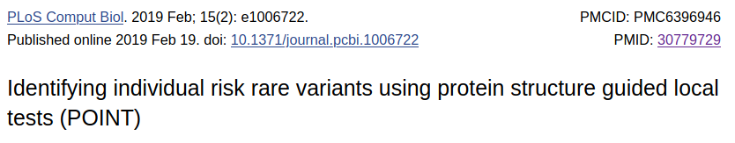
Methods
Bringing protein structures to the germline genetics community
SKAT
Output
SKAT-O
SetID
2 columns file
Varid | Struc. Feature id
rs | feature1
rs | feature2
... | ...
POINT

Slide 18

Generation of protein interfaces catalogue
Generation of protein interfaces catalogue following the steps specified in:
Porta-Pardo E, Garcia-Alonso L, Hrabe T, Dopazo J, Godzik A. A Pan-Cancer Catalogue of Cancer Driver Protein Interaction Interfaces. PLoS Comput Biol. 2015;11(10):e1004518.​
PROTEIN INTERFACES DB

Slide 19
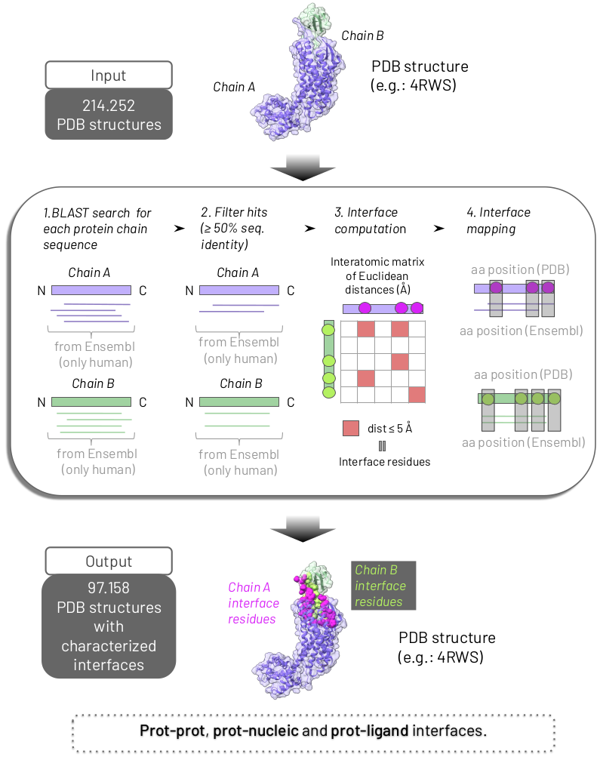
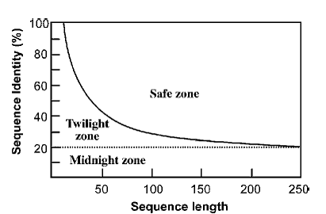

Slide 20
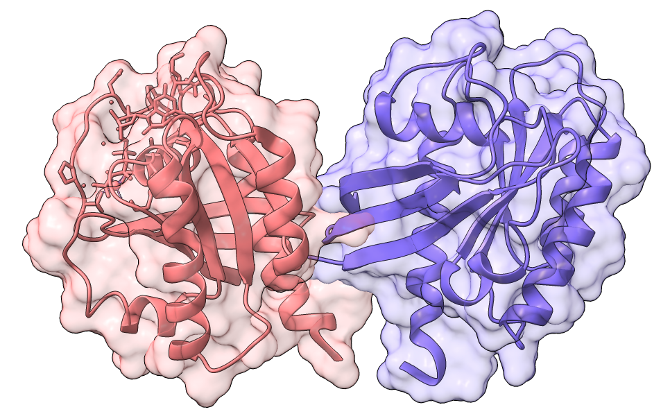
Generation of protein interfaces catalogue

Slide 21
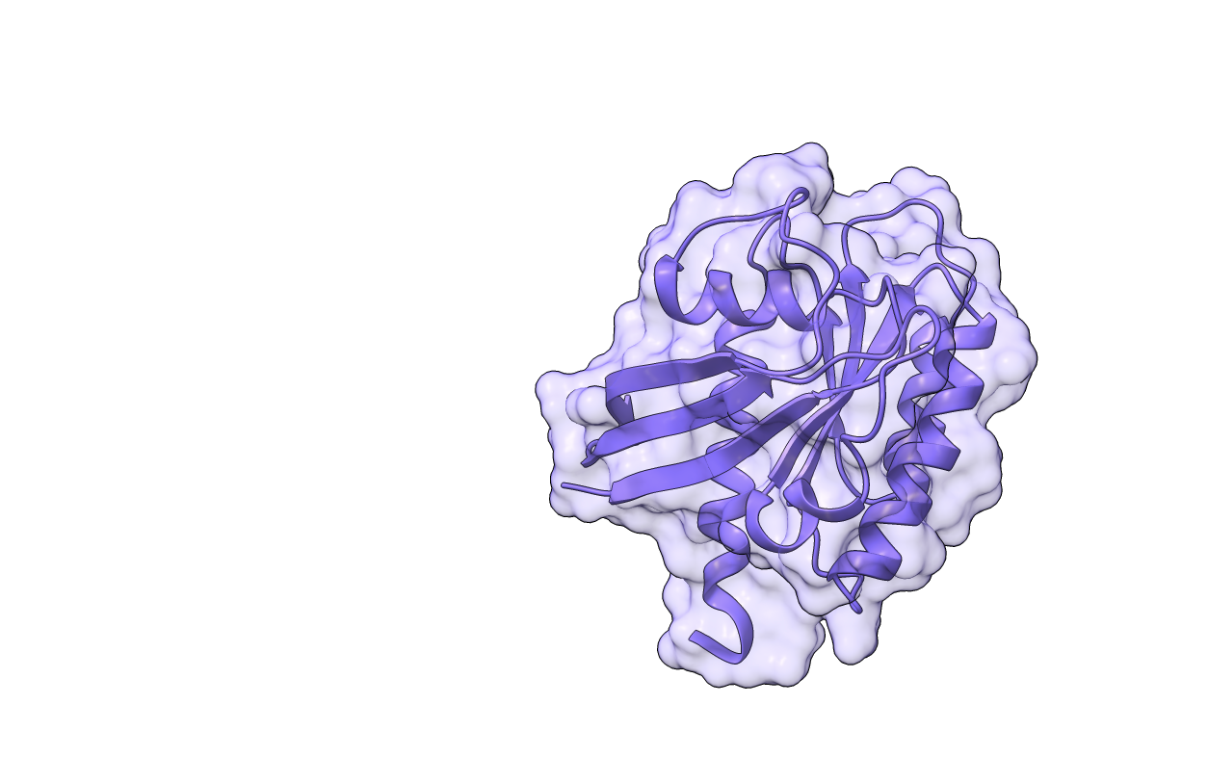

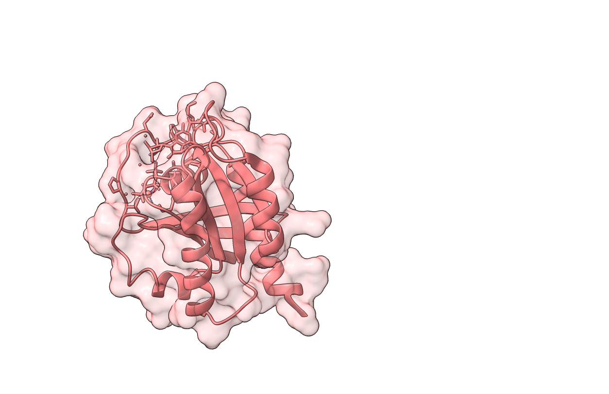
Generation of protein interfaces catalogue
MRTGEGFLCVFAINNTKSFE
Chain sequences with interfaces
MTEYKLVVVGAGGVGKSAL
MRTGEGFLCVFAINNTKSFE
MTEYKLVVVGAGGVGKSAL
Distance matrix
≤ 5Å*
*Defined in: Porta-pardo E, Garcia-alonso L, Hrabe T, Dopazo J, Godzik A. A Pan-Cancer Catalogue of Cancer Driver Protein Interaction Interfaces. PLoS Comput Biol. 2015;11(10):e1004518.

Slide 22
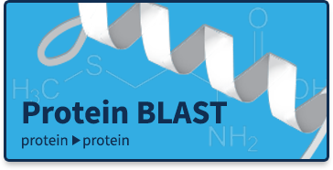


Generation of protein interfaces catalogue
Chain sequences with interfaces
Retrieve sequences with at least 50% of sequence identity
Retrieve interface residues of that sequences.
MRTGEGFLCVFAINNTKSFE
MTEYKLVVVGAGGVGKSAL
AKSPPSAPGARSPSRTRRGRSPCAGPVGARPRPRPAPAPAPGAVAPASGGAGAPGLAAPVE
AMTEYKLVVVGAGGVGKSALTIQLIQNHFVDEYDPTIEDSYRKQVVIDGETCLLDILDTAGQE EYSAMRDQYMRTGEGFLCVFAINNTKSFEDIHQYREQIKRVKDSDDVPMVLVGNKCDLAAR TVESRQAQDLARSYGIPYIETSAKTRQGVEDAFYTLVREIRQHKLRKLNPPDESGPGCMSCKC
RSPSRTRRGRSSCAGPAGARPRPRPAPAPAPAPGAVAPASGGAGAPGLAAAVEAMTEYKLV VVGAGGVGKSALTIQLIQNHFVDEYDPTIEDSYRKQVVIDGETCLLDILDTAGQEEYSAMRDQ YMRTGEGFLCVFAINNTKSFEDIHQYREQIKRVKDSDDVPMVLVGNKCDLAARTVESRQAQ PASGGAGAPGVAASIEAMTEYKLVVVGAGGVGKSALTIQLIQNHFVDEYDPTIEDSY
RKQVVIDGETCLLDILDTAGQEEYSAMRDQYMRTGEGFLCVFAINNTKSFEDIHQYREQIKRVKDSDDVPMVLVGNKCDL
Proteome
of reference
PROTEIN INTERFACES DB

Slide 23
PDB pitfalls
Sequence starting positions are not always 1. They can be positive or negative numbers.
Modified residues e.g.: MSC.
Inserts e.g.: instead of counting residues position like 1, 2, 3, 4, 5, … it could be 1, 2.A, 2.B, 2.C, 3, ...
If the structure is partially resolved part of the sequence will be missing
...

Slide 24

ClinVar
A. thaliana
OR
ExAC
SARS-CoV-2
OR
TCGA
PROTEIN INTERFACES DB
OR
UK Biobank
VARIANTS DB

Slide 25
Results

Slide 26
Mapping to protein interfaces
 | TCGA | UK Biobank | ExAC
Input (variants) | 3.600.963 | 8.959.609 | 9.362.318
PDBmapper running time | 30 min​ | 43 min | 48 min
Execution​ | Local work station​
Cpus​ | 7​
Average memory usage ​ | ~ 85MB​
 | Output
Output (Mapped variants​) | 344.229​ | 1.408.156 | 2.235.846

Slide 27
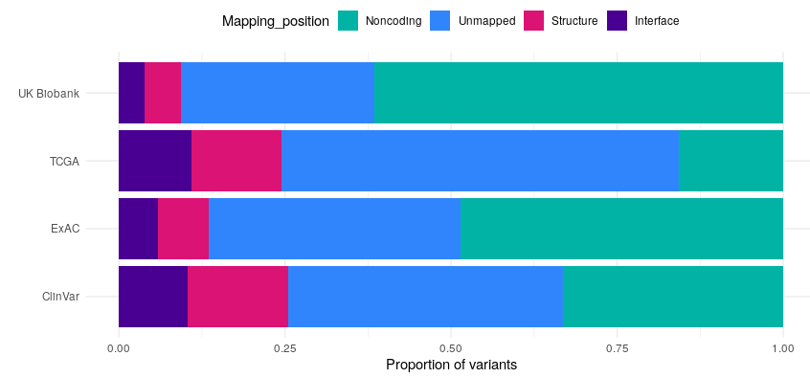
All variants coverage (one isoform per gene)

Slide 28
PDBmapper: advantages and limitations
Advantages
Fast and Big Data
Pip application
Not disease related
Versatility of input
A priori: Identifies variants on interfaces. User can provide other 3D info of protein (e.g.: surface, domain, …)
Not human-centered
Limitations
Proteome coverage of PDB
Interface curation method

Slide 29
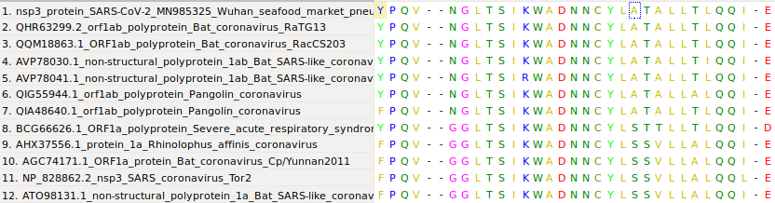
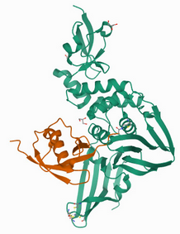
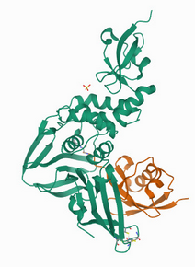
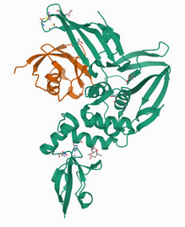
Mapping mutations and more...
alignment of nsp3 protein of coronaviruses
SARS2
NSP3
+
ISG15
SARS
MERS

Slide 30

Thank you! Questions?
2m

